Slide 1
OSSEC HIDS Project
Host-Based Intrusion Detection
Suspicious Process Execution Detection
Hyukjin Jeong

Slide 2
Project Overview
Install and configure OSSEC on an Ubuntu Virtual Machine
Detect suspicious login attempts (SSH brute-force simulation)
Detect suspicious process execution using auditd + OSSEC
Analyze alerts generated by OSSEC to understand HIDS behavior

Slide 3
What is a HIDS?
Host-Based Intrusion Detection System
Monitors authentication logs, system files, and suspicious activities
Generates alerts based on predefined detection rules
Lightweight and suitable for single-host monitoring

Slide 4
System Architecture
Ubuntu 25.04 (ARM) running inside VMware Fusion (macOS)
OSSEC installed in local mode
Monitors:
/var/log/auth.log for authentication and login events
Audit logs (via auditd) for suspicious process execution
Alerts stored in : /var/ossec/logs/alerts/alerts.log

Slide 5
Installation Process
After installation, verified the following process:
ossec-monitord (monitoring)
ossec-logcollector (log watcher)
ossec-syscheckd (file integrity)
ossec-analysisd
ossec-execd

Slide 6
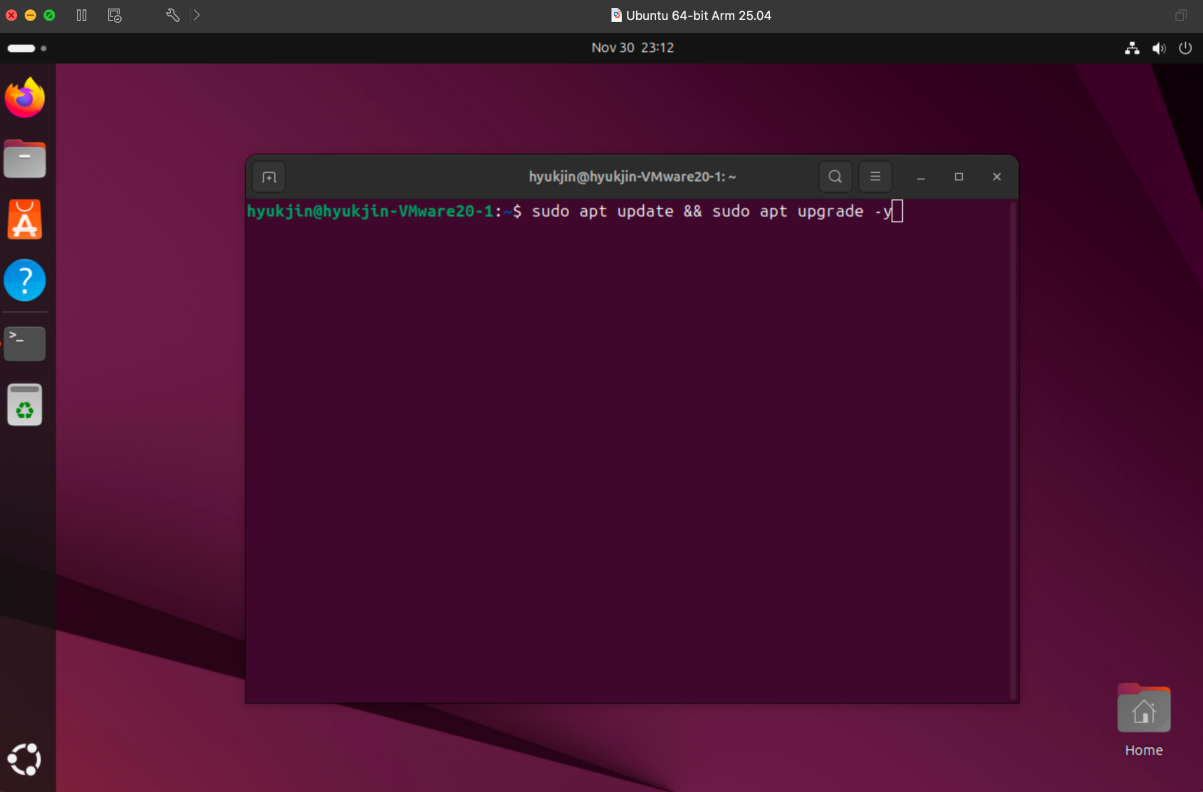
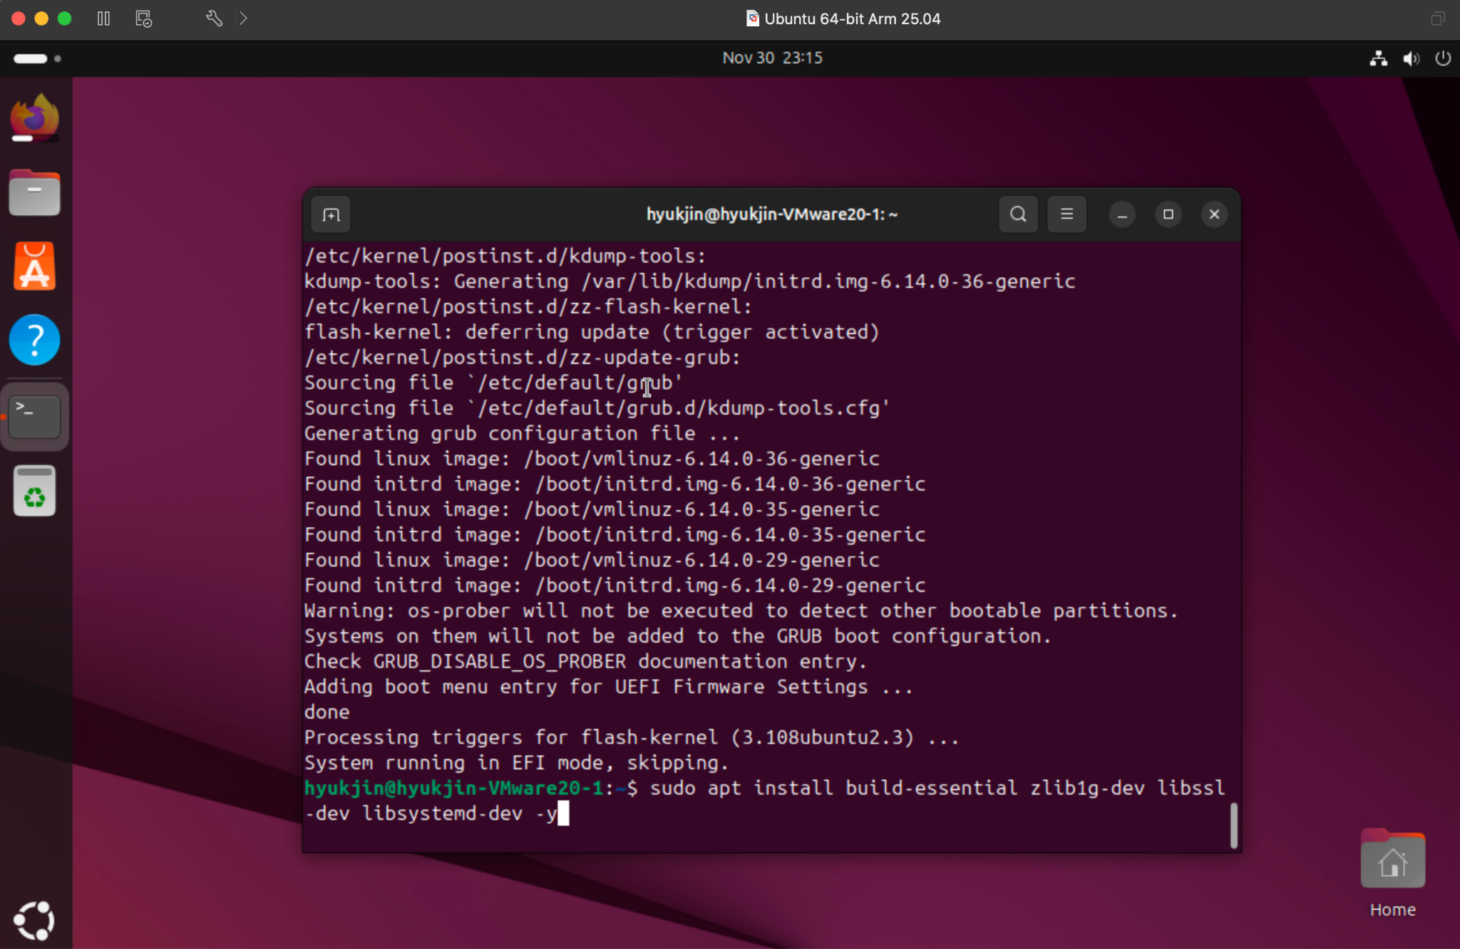

Slide 7
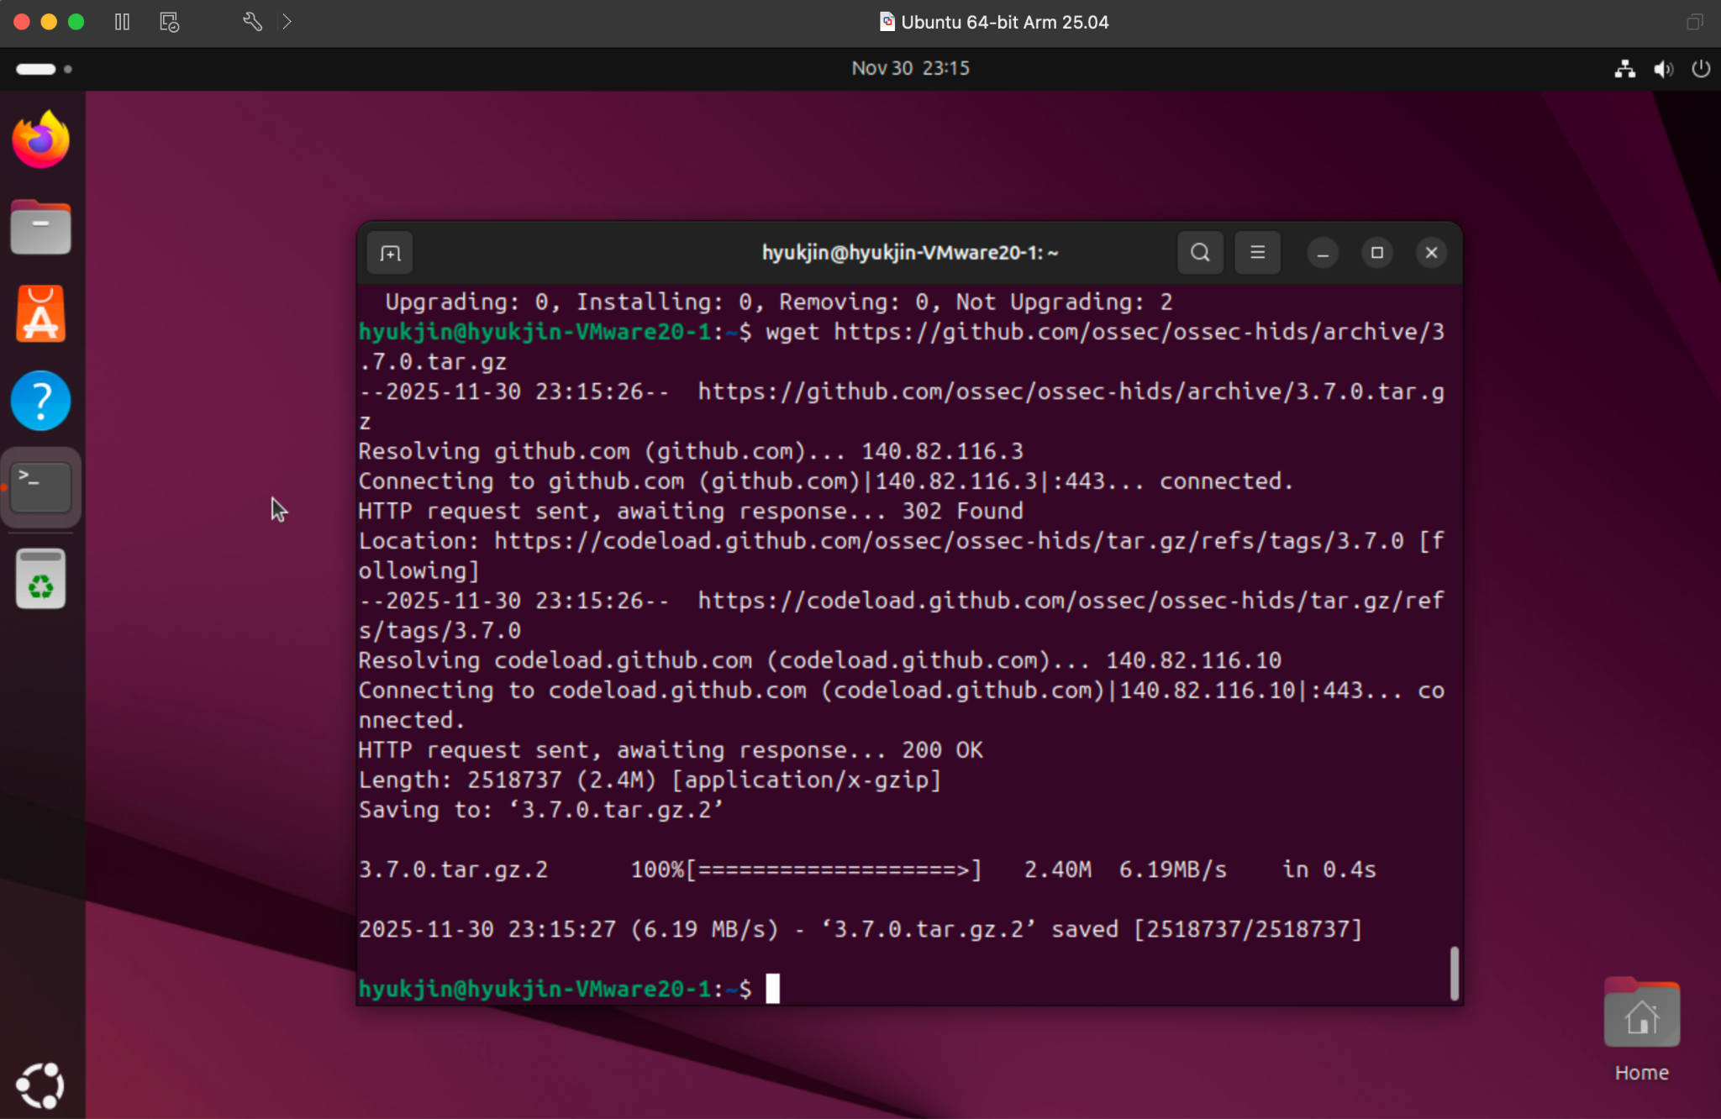
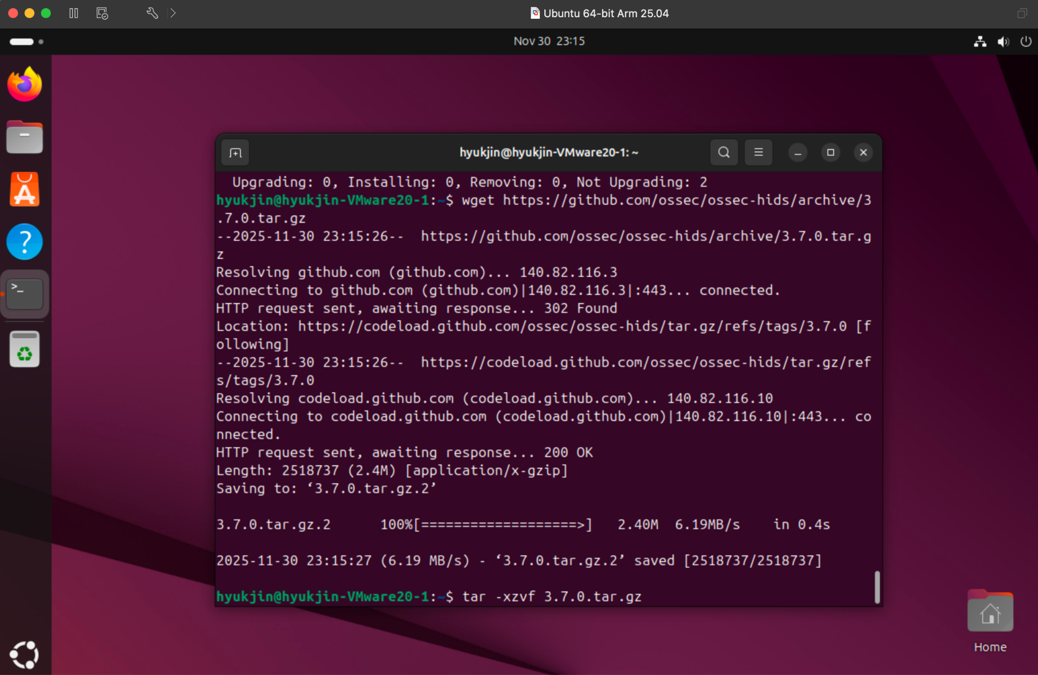

Slide 8
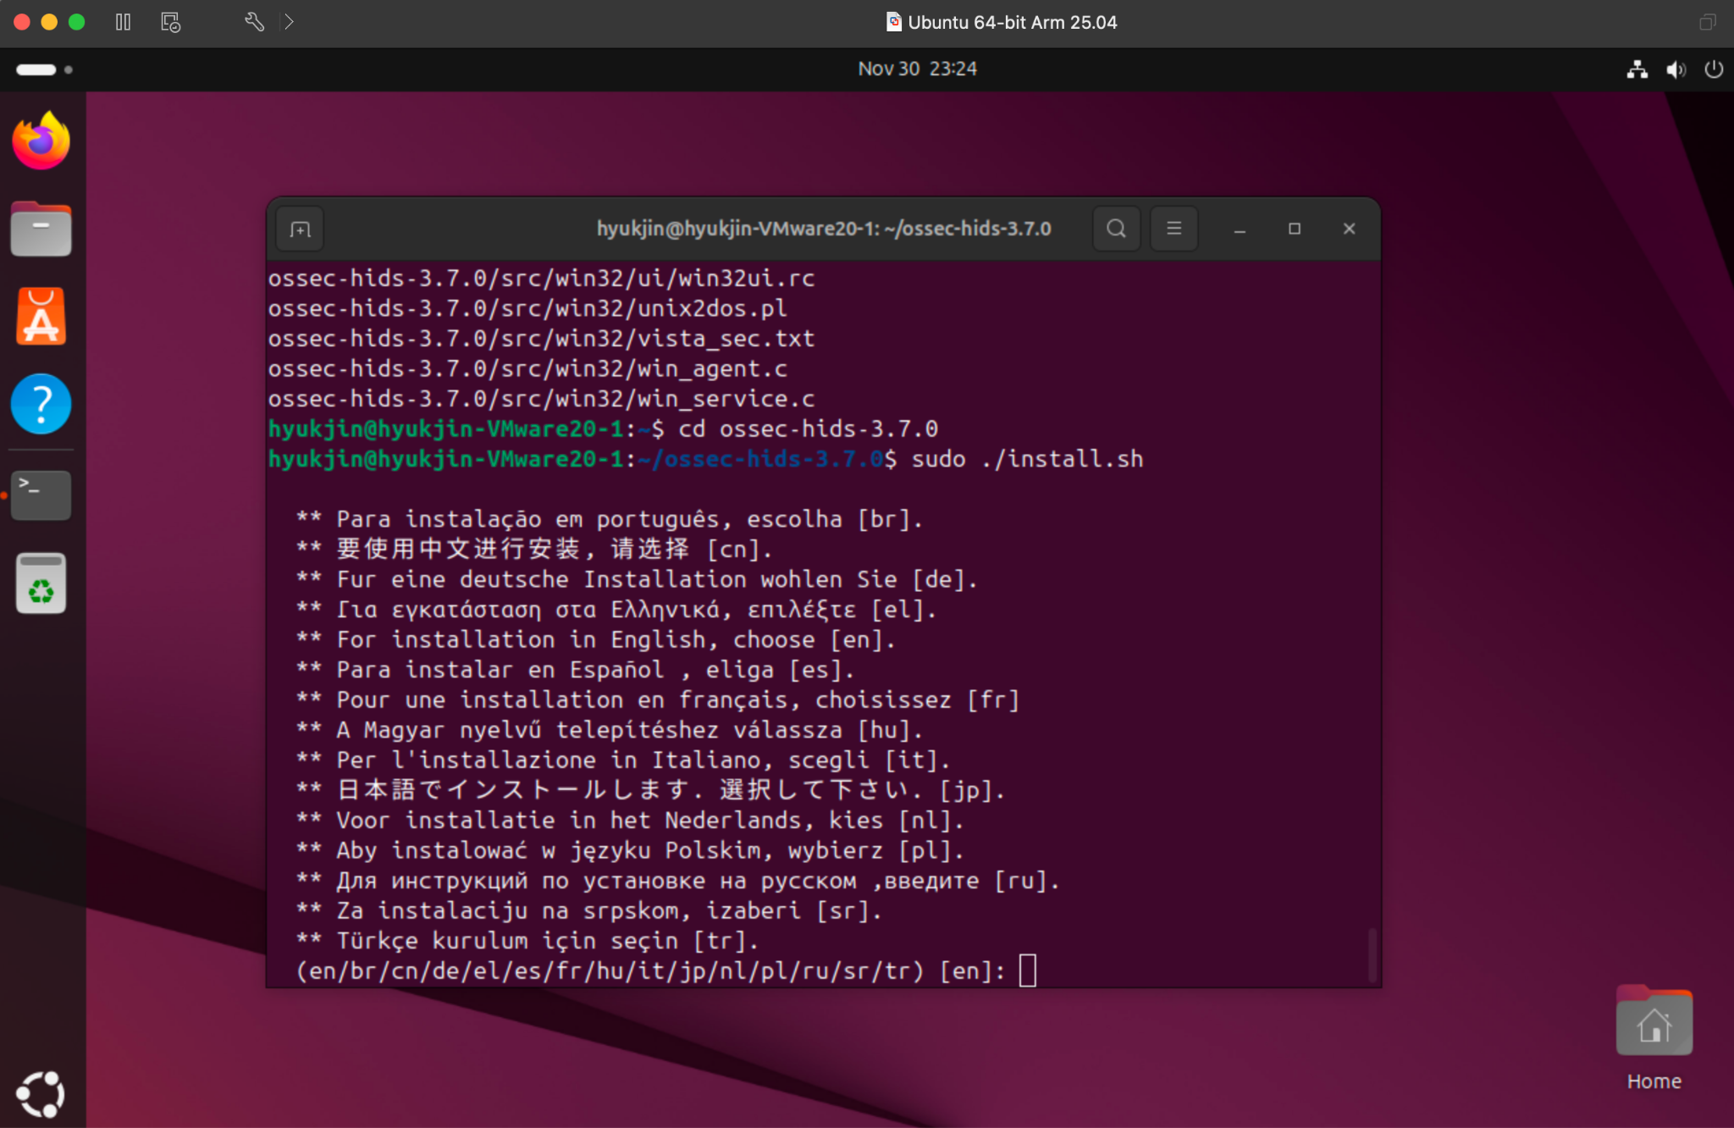
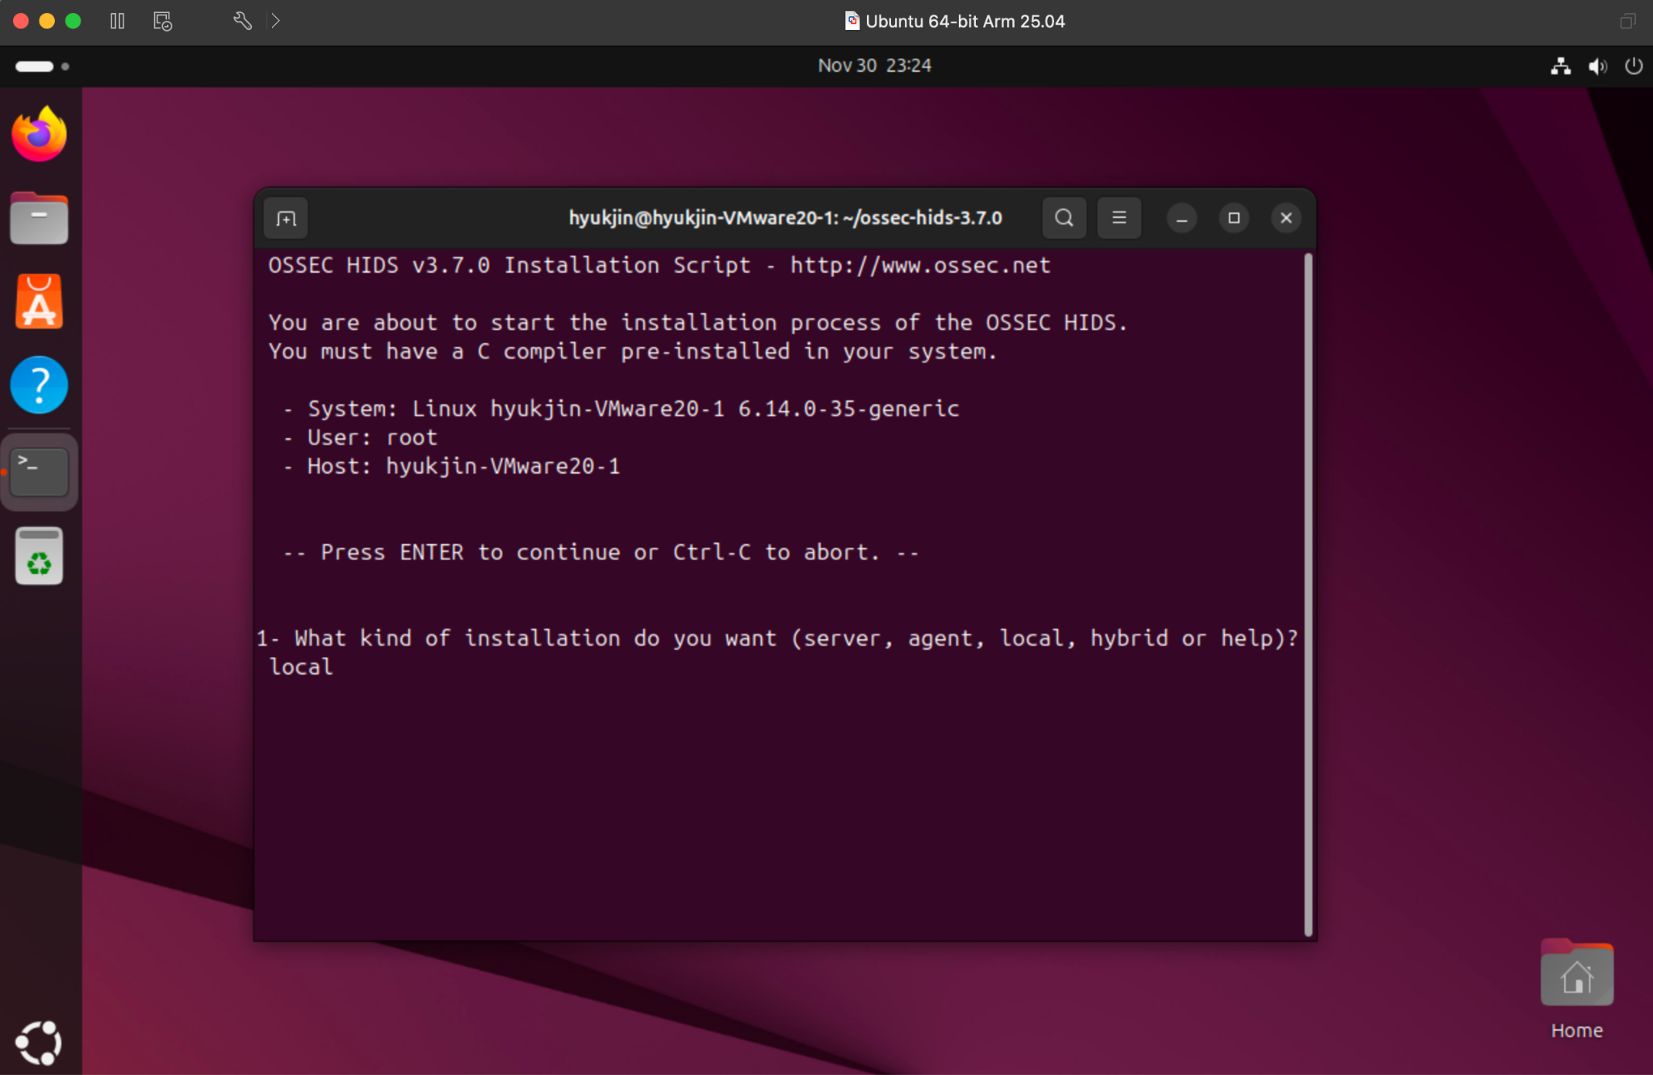

Slide 9
SSH Login Failure Detection
Simulated brute-force attempts using invalid user:
Example: ssh wronguser@localhost
OSSEC detected multiple failed login events, including invalid usernames and repeated authentication failures
Example Alert:
“Rule 5710 → Attempt to login using a non-existent user”

Slide 10
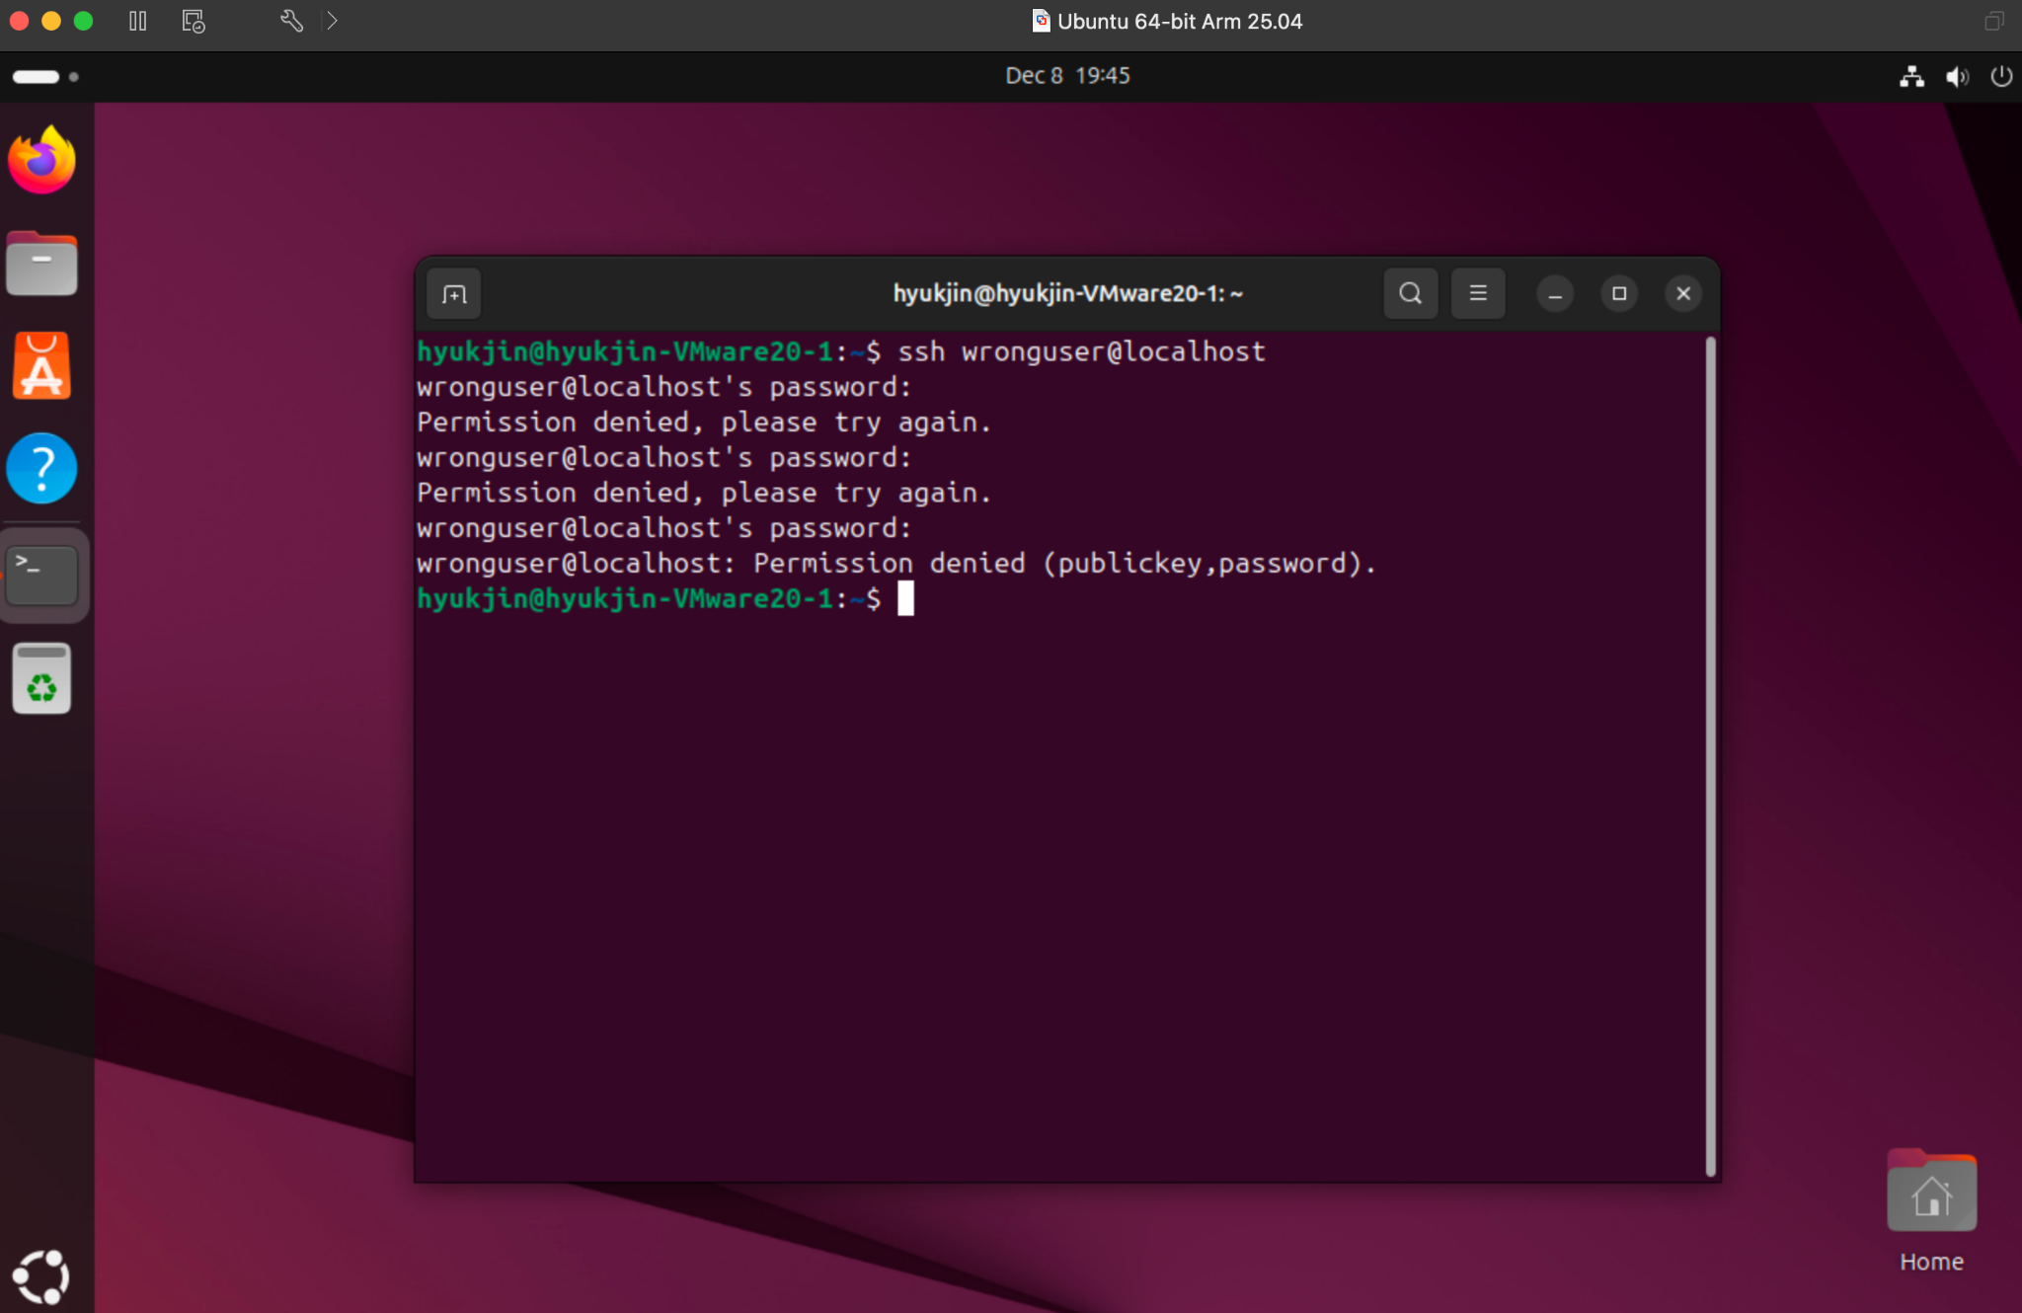
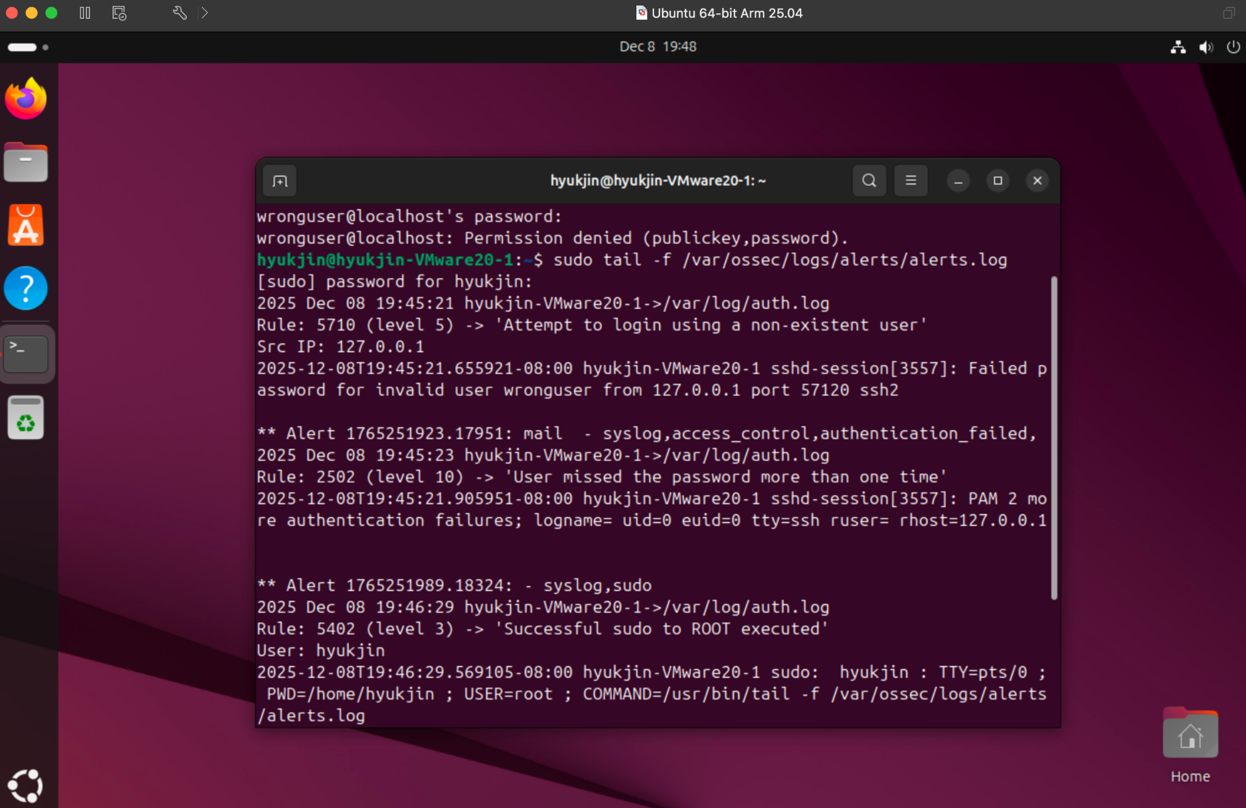

Slide 11
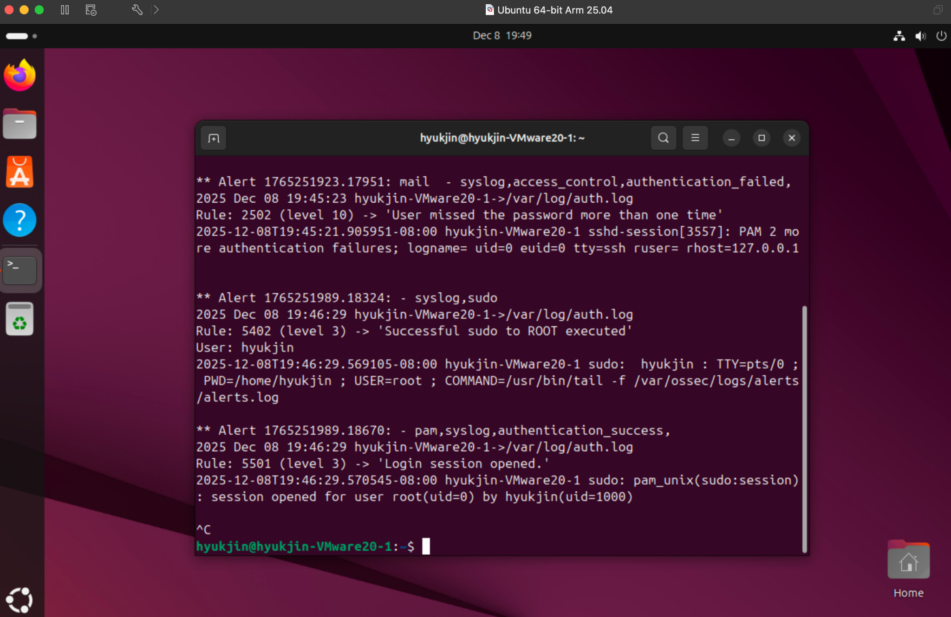

Slide 12
Suspicious Process Execution Detection (Auditd + OSSEC)
Executed an unknown script to simulate attacker behavior
auditd monitors process events using a watch rule
OSSEC analyzes audit logs and applies custom rule 100100
Expected alert:
“Rule 100100 → Suspicious process execution detected: Unknown executable ran”

Slide 13
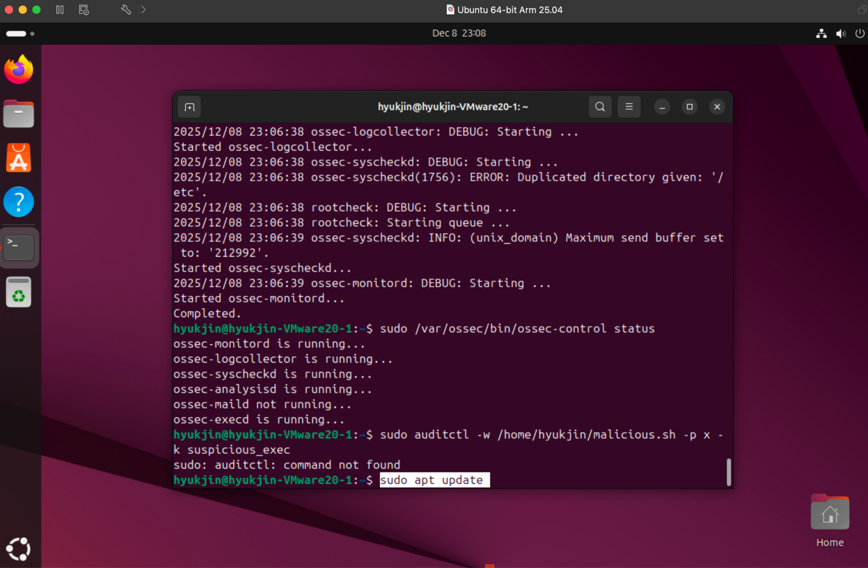
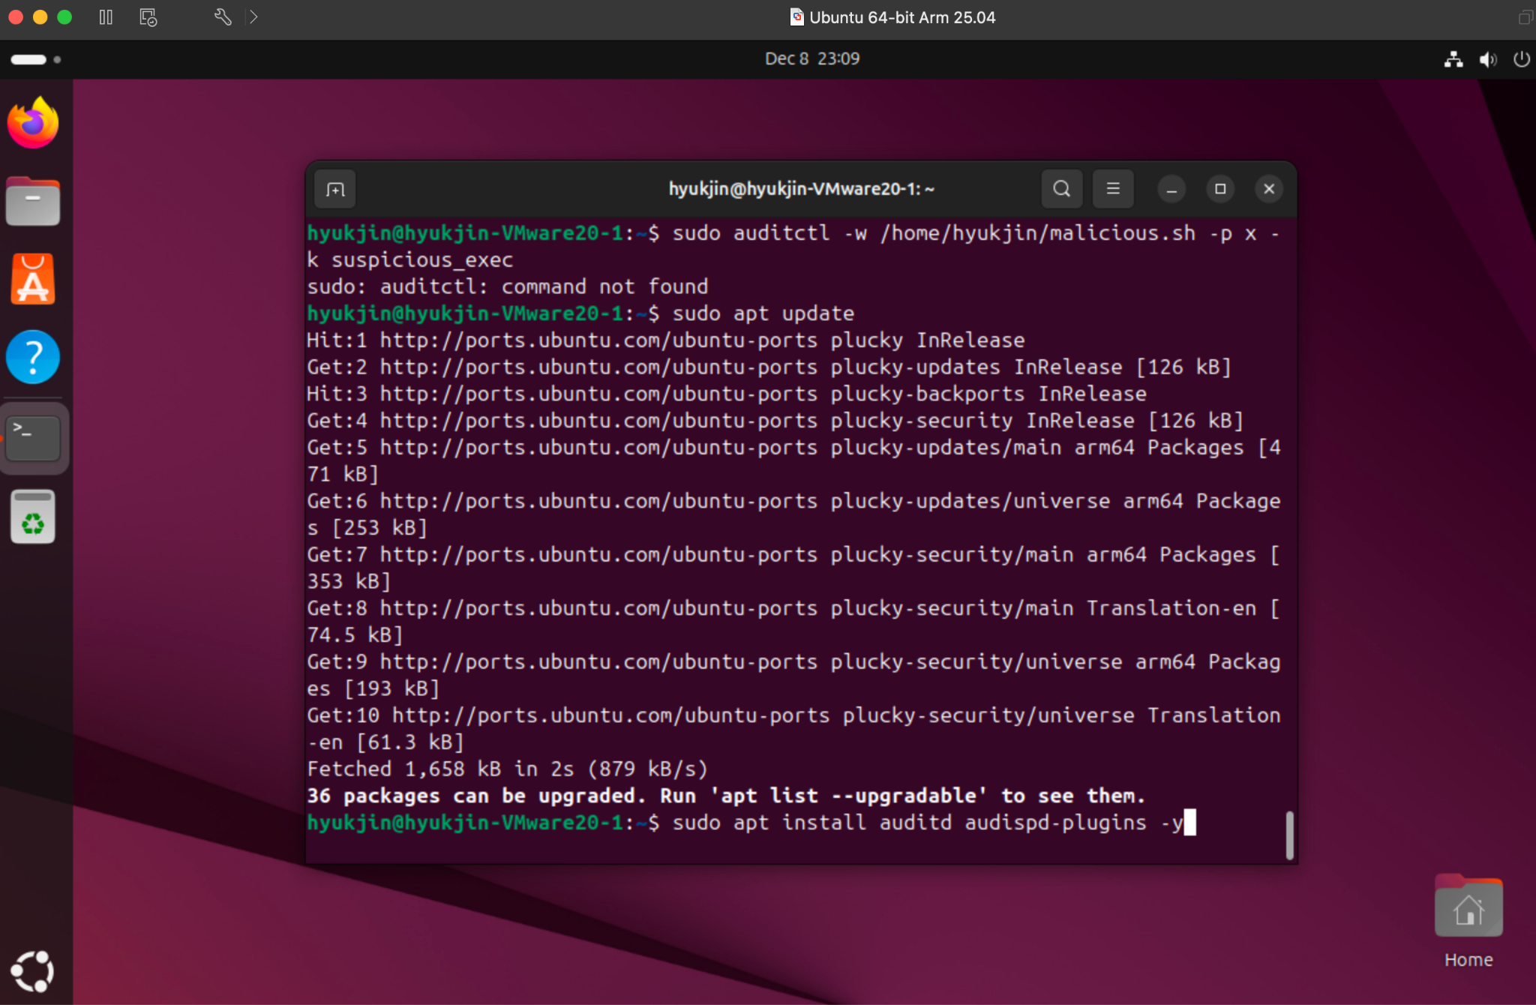

Slide 14
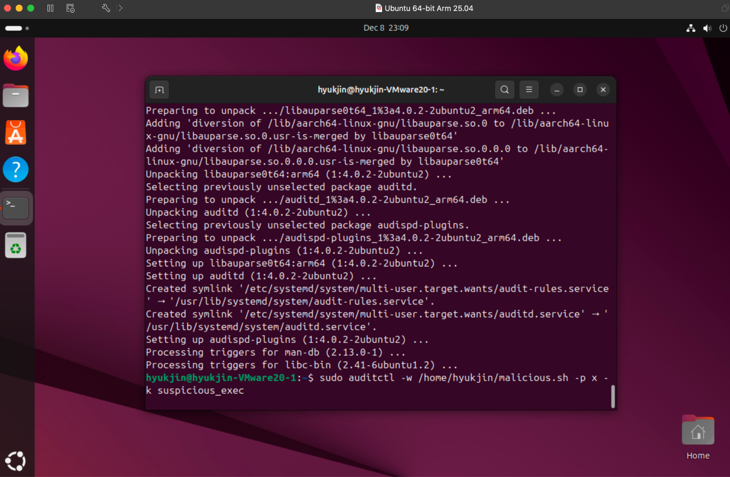
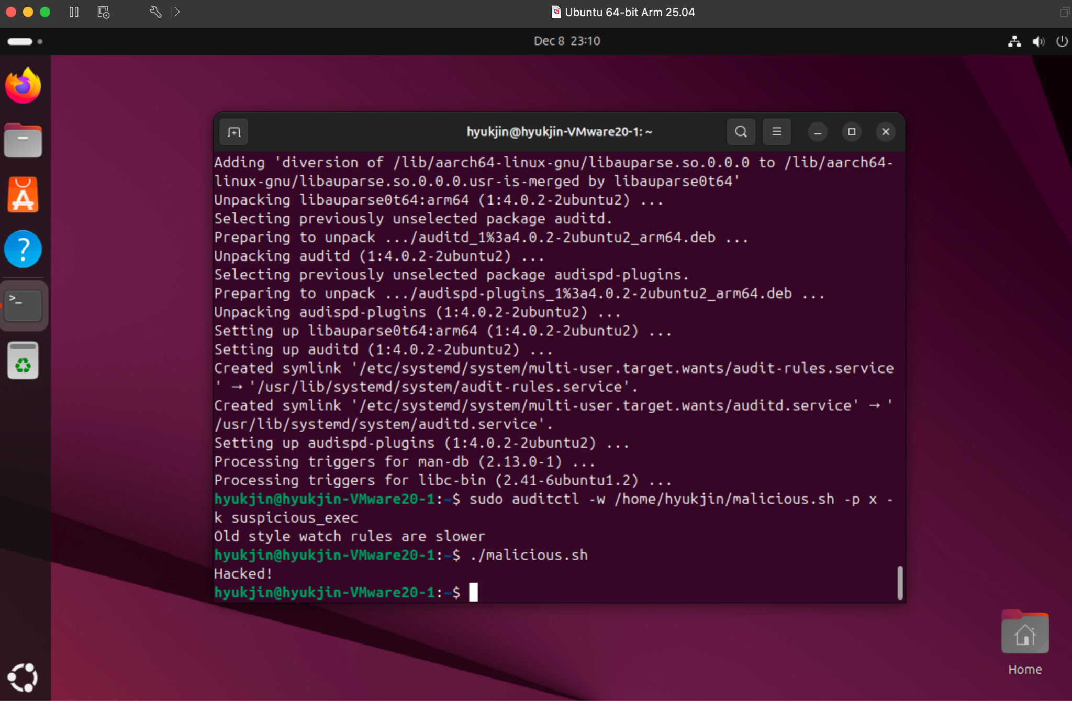

Slide 15
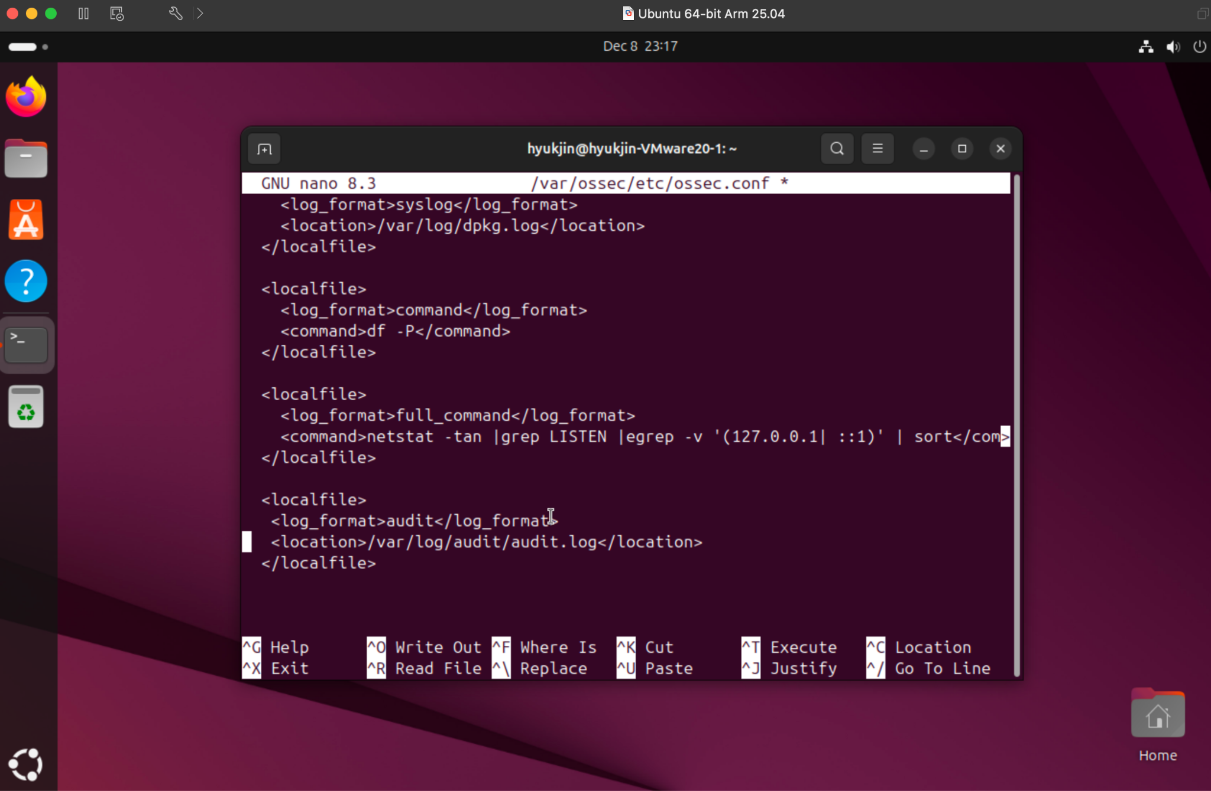
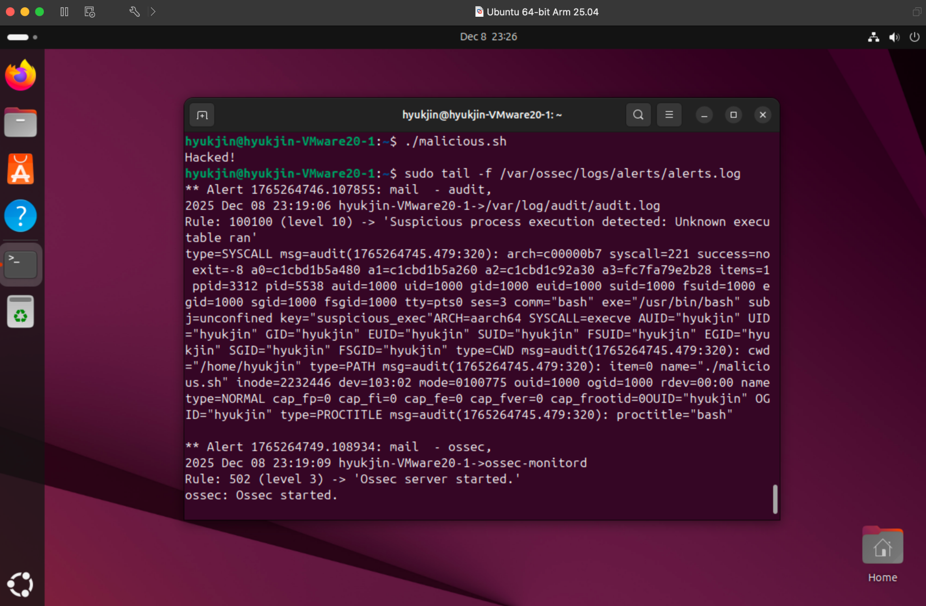

Slide 16
Troubleshooting & Fixes
Installed missing build dependencies (zlib, OpenSSL, headers, libsystemd) required for OSSEC build process
Corrected syscheck configuration path issues caused by ARM specific directory differences
Enabled auditd and OSSEC real time monitoring after verifying service failures
Resolved duplicated configuration warnings during OSSEC startup

Slide 17
Conclusion
Successfully installed and configured OSSEC HIDS on Ubuntu VM
Detected SSH brute-force attempts through log monitoring
Implemented suspicious process execution detection using auditd + OSSEC
Learned practical HIDS implementation, rule configuration, alert interpretation, and troubleshooting

Slide 18
Thank you

